Slide 1
VVSG 2.0 Requirements Overview
Mary Brady
NIST Voting, Program Manager
Mary.Brady@nist.gov

Slide 2
Agenda
Elections: The Changing Landscape
The Voting System and the Process
What’s New
VVSG 2.0 Major Changes
Core Requirements
Accessibility/Usability/Privacy
Cybersecurity
Summary
Questions

Slide 3
Elections: The Changing Landscape

Slide 4
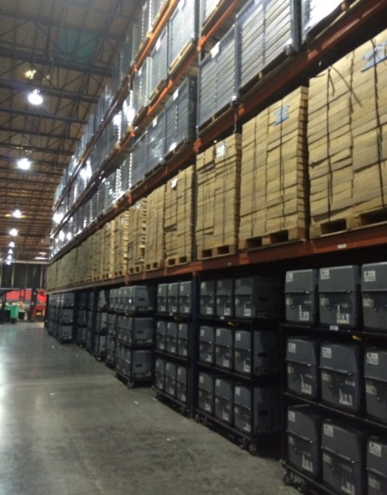
Range of Election Jurisdictions
LA County Warehouse
Source: Kim Brace

Slide 5
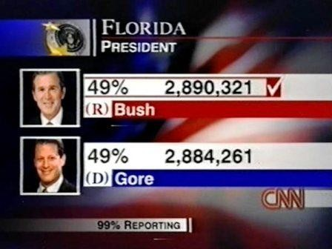
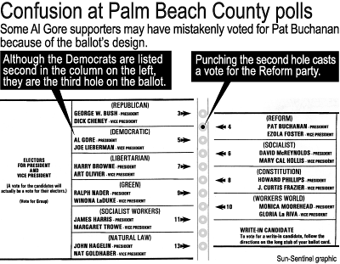
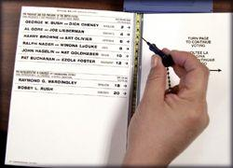
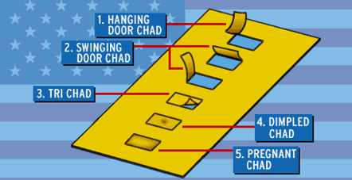
2000 Presidential Election

Slide 6
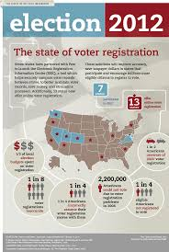
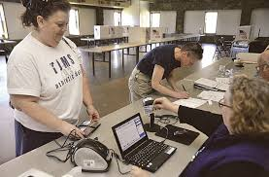
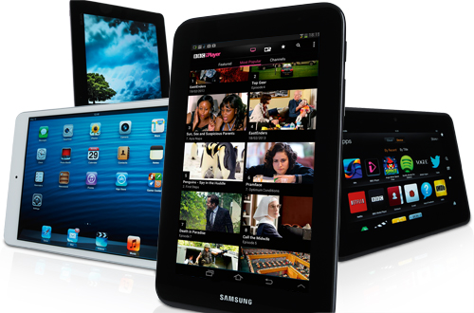
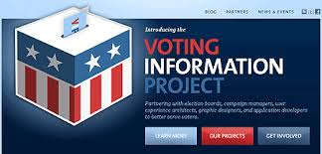
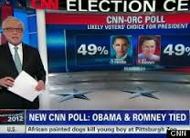
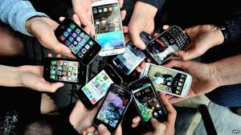
Improving U.S. Voting Systems

Slide 7
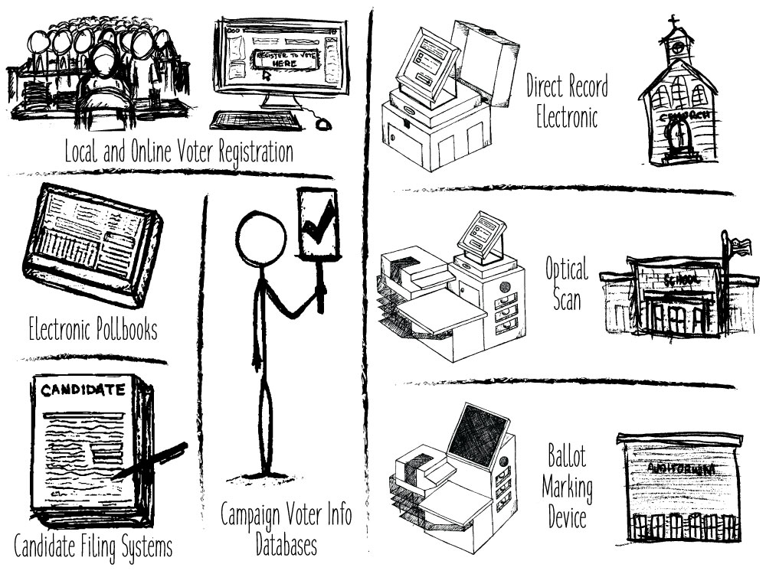
Improving U.S. Voting Systems
Notes:
Scope of the VVSG

Slide 8
Range of Election Jurisdictions
LA County Warehouse
Source: Kim Brace

Slide 9
the Voting System… … and The Process

Slide 10
Election Systems
Belfer Center, The State and Local Election Cybersecurity Playbook

Slide 11
Current VVSG 2.0 Definition
“Equipment (including hardware, firmware, and software), materials, and documentation used to enact the following functions of an election:
define elections and ballot styles,
configure voting equipment,
identify and validate voting equipment configurations,
perform logic and accuracy tests,
activate ballots for voters,
record votes cast by voters,
count votes,
label ballots needing special treatment
generate reports,
export election data,
archive election data, and
produce records in support of audits.”
EAC Public Hearing March 27, 2020

Slide 12
VVSG 2.0 Development
Prior Voting Guidelines
VVSG 1.0 (2005)
TGDC VVSG 2.0 (2007)
VVSG 1.1 (2015)
EAC
Standards Board
Board of Advisors
TGDC
NIST Director
NIST
PWG’s
VVSG 2.0 (2020) Guidelines
Tap into as many experts as possible
Get continual feedback

Slide 13
NIST-EAC Public Working Groups
Election Groups
Developed election process models that served as the basis for use cases and the core functions
Pre-Election (103 members)
Election: (107 members)
Post-Election: (96 members)
Constituency Groups
Conducted gap analyses and developed draft VVSG 2.0 Principles and Guidelines
U&A (105 members)
Cybersecurity (121 members)
Interoperability (158 members)
Testing (84 members)

Slide 14
VVSG 2.0: Principles & Guidelines*
 | Principle | Guidelines
1 | High Quality Design | 3
2 | High Quality Implementation | 7
3 | Transparency | 3
4 | Interoperability | 4
5 | Equivalent and Consistent Voter Access | 2
6 | Voter Privacy | 2
7 | Marked, Verified, and Cast as Intended | 3
 | Principle | Guidelines
8 | Robust, Safe, Usable, and Accessible | 3
9 | Auditability | 4
10 | Ballot Secrecy | 2
11 | Access Control | 5
12 | Physical Security | 2
13 | Data Protection | 4
14 | System Integrity | 4
15 | Detection and Monitoring | 4
*Adopted by the TGDC, Sept 2017

Slide 15
New Structure For all stakeholders, plain language
VVSG 2.0
Principles and Guidelines
Requirements
Test Methods
Principles:
High-level design goals
Guidelines:
Broad system design details for election officials
Requirements:
Low-level guidance for manufacturers and test laboratories
Test Methods:
Guidance to ensure necessary breadth and depth when testing voting systems
EAC Public Hearing March 27, 2020

Slide 16
Requirements Update Process
Bi-weekly meetings of Working Groups + email list discussions
Start with past voting guidelines, including VVSG 1.0, 1.1,TGDC 2007, feedback from testing and certification, and reports of problems during elections
Examine relevant external regulations and standards
Consider reports (PCEA, NAS Securing the Vote, Senate Intelligence Committee), DHS products and alerts, and relevant research results from the past decade
Examine updated best practices in elections or technology
Engage a wide variety of stakeholders in deliberations

Slide 17

TGDC Deliberations
TGDC Update
Feb
2020
Sept 2019
Dec
2019
Aug-Sep: Bring TGDC up-to-date on current status of requirements and open issues.
Accessibility and security
Clear boundaries between voting and election systems
Number of accessible machines and ballots produced
Nov
2019
Open Issues:
Common Data Formats
Indirect Voter Associations
Barcodes
Wireless
Internet technology
Voting system definition
Review of hybrid solutions
E2E systems
Barcodes
SW independence + ballot secrecy
Wireless, Internet
Password complexity, random numbers
Log file preservation
Updated MIL-standards
Provisional Standards, Transparent Public Comment Processes

Slide 18
What’s New [1]
Represents the latest in both industry and technology best practices, requiring significant updates in many aspects of voting systems.
Human factors requirements now reference federal accessibility standards, Section 508, and Web Content Accessibility Guidelines.
Voter interface requirements have been updated to incorporate recent usability research and interactions that result from modern devices and fully support accessibility throughout the voting process.

Slide 19
What’s New [2]
Common data formats are now required, and provide low-level support needed for risk-limiting audits.
Defensive coding practices, reliability and electrical requirements were reviewed, updated, and streamlined.
Guidance relevant to testing and certification has been moved to the EAC’s testing and certification manual.

Slide 20
What’s New [3]
New security requirements call for software independence and support auditing methods, including risk-limiting audits.
Dedicated section on ballot secrecy, preventing voter information from being carried through to the voting system.
Two-factor authentication is now mandated for critical voting operations.
Cryptographic protection and new system integrity requirements ensure that security protections developed by industry over the past decade are built into the voting system.

Slide 21
What’s New [4]
Includes risk assessment and supply chain risk management, secure configurations and system hardening, exploit mitigation, sandboxing and runtime integrity.
All sections of the prior VVSG have been reviewed, rethought, and updated to meet modern expectations about how voters should interact with the voting system and how voting systems should be designed and developed.

Slide 22
VVSG CORE

Slide 23
Where to find the Core Requirements?
The core requirements fall under Principles 1 and 2
Documentation is covered in Principle 3
Requirements in Human Factors and Security are linked from the core requirements in those areas
 | Principle
1 | High Quality Design
2 | High Quality Implementation
3 | Transparency
4 | Interoperability

Slide 24
VVSG 2.0 Changes [1]
Voting functions are organized as phases of an election
Ensures usability, security, and reliability are designed from the start
Replaces code commentary with well-established coding practices and provides additional defensive coding practices
Streamlines electrical requirements making them less costly to test

Slide 25
VVSG 2.0 Changes [2]
Mandates greater interoperability and moves VVSG in direction of eventual component certification
When CDF does not cover data transfers between components, manufacturer must document format
All hardware interfaces must use common methods and standards
COTS hardware can be used as long as requirements are still satisfied
Bar codes and other data encodings must use open standard and include documentation

Slide 26
VVSG 2.0 Changes [3]
Updated guidance and technical references for accuracy, reliability, environment, volume, and stress testing
Comprehensive documentation for design, evaluation, and operation (i.e., traditional TDP materials) detailed in transparency section

Slide 27
Common Data Formats
NIST 1500-102 Cast Vote Records – for cast vote records created when scanning paper ballots, used to determine election results - see https://github.com/usnistgov/CastVoteRecords.
NIST 1500-101 Election Event Logging – for election-related events logged by election devices for use in auditing - see https://github.com/usnistgov/ElectionEventLogging.
NIST 1500-100 Election Results Reporting – for defining election and ballot information and for reporting election results - see https://github.com/usnistgov/ElectionResultsReporting.
NIST 1500-103 Voter Records Interchange – for voter registration-related records to support voter registration and for voter registration database exchanges – see https://github.com/usnistgov/VoterRecordsInterchange.

Slide 28
Thank You!

